Slide 1
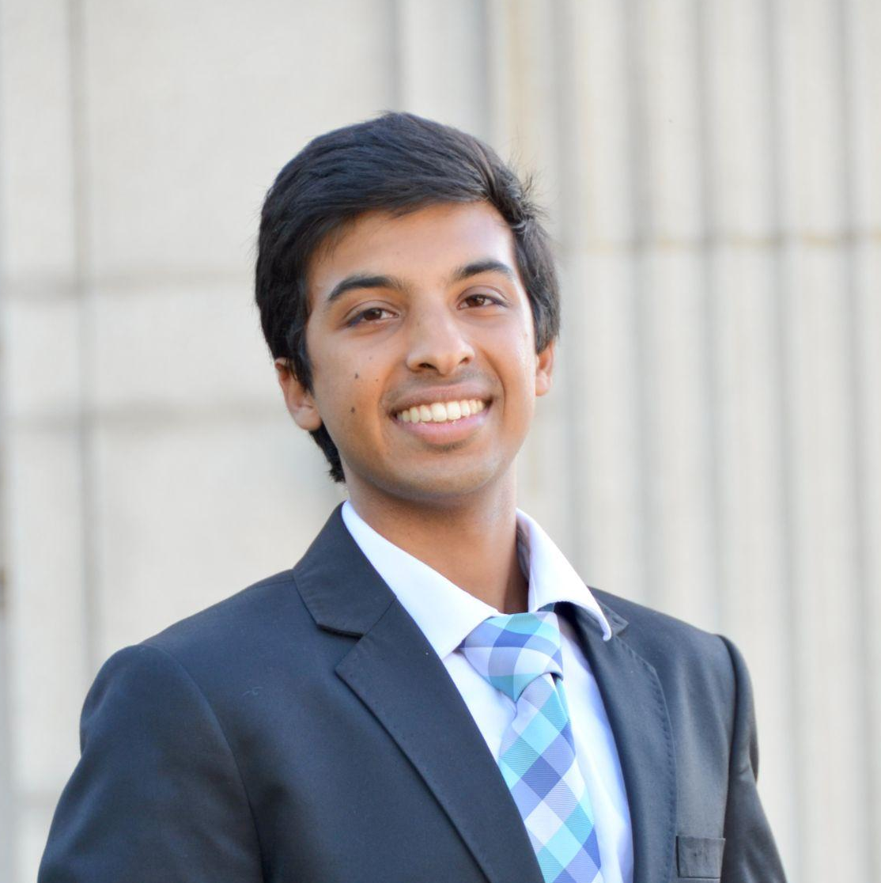
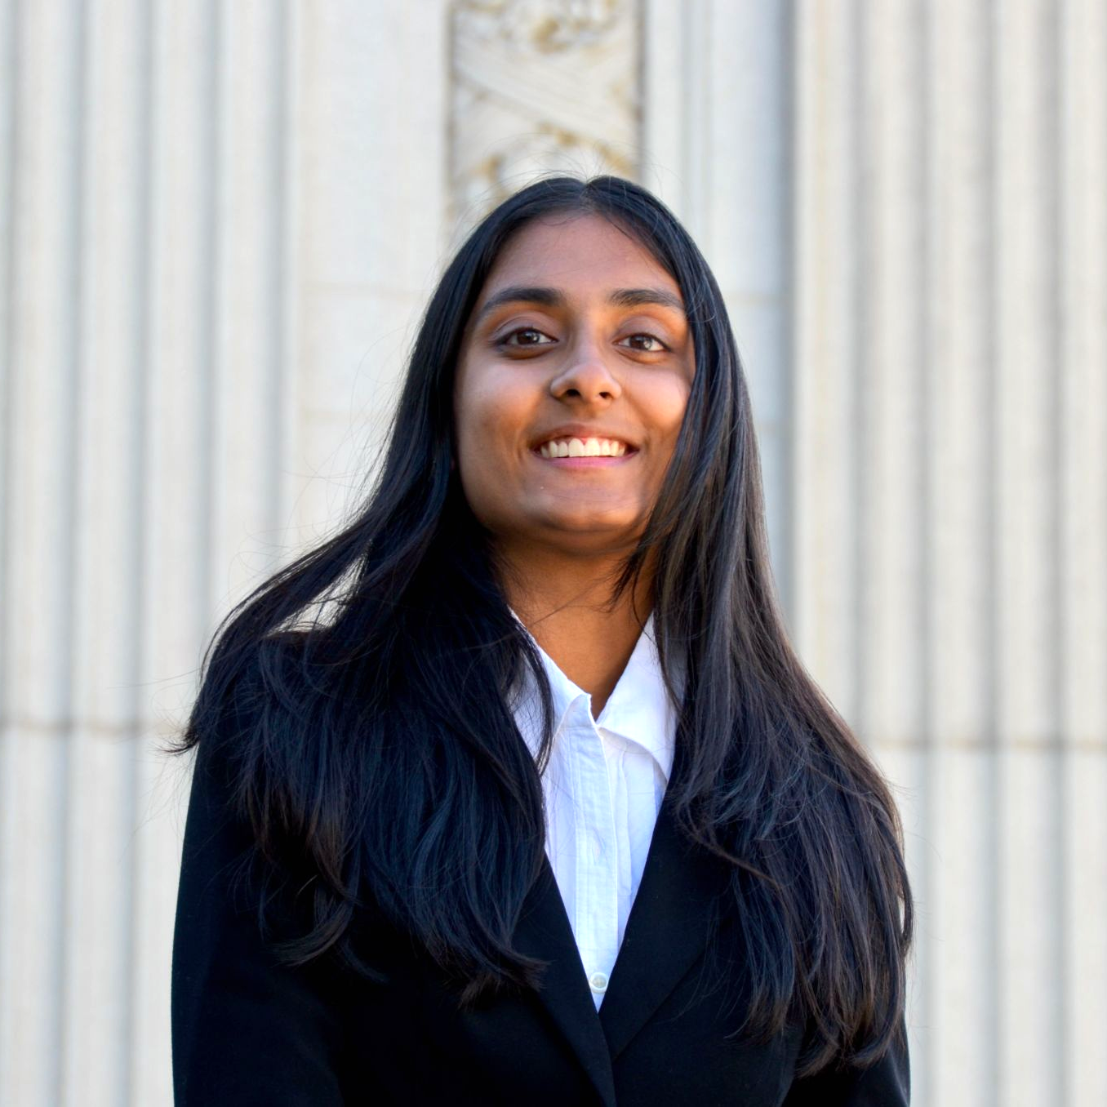

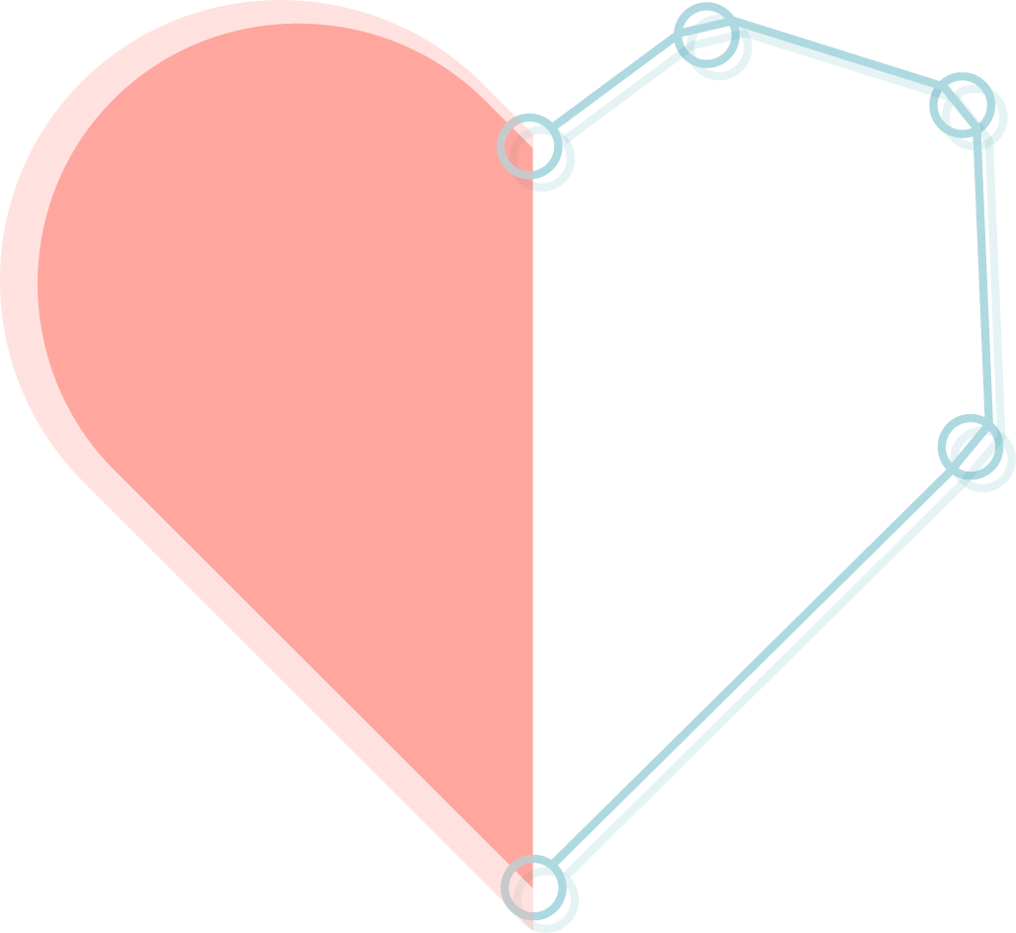
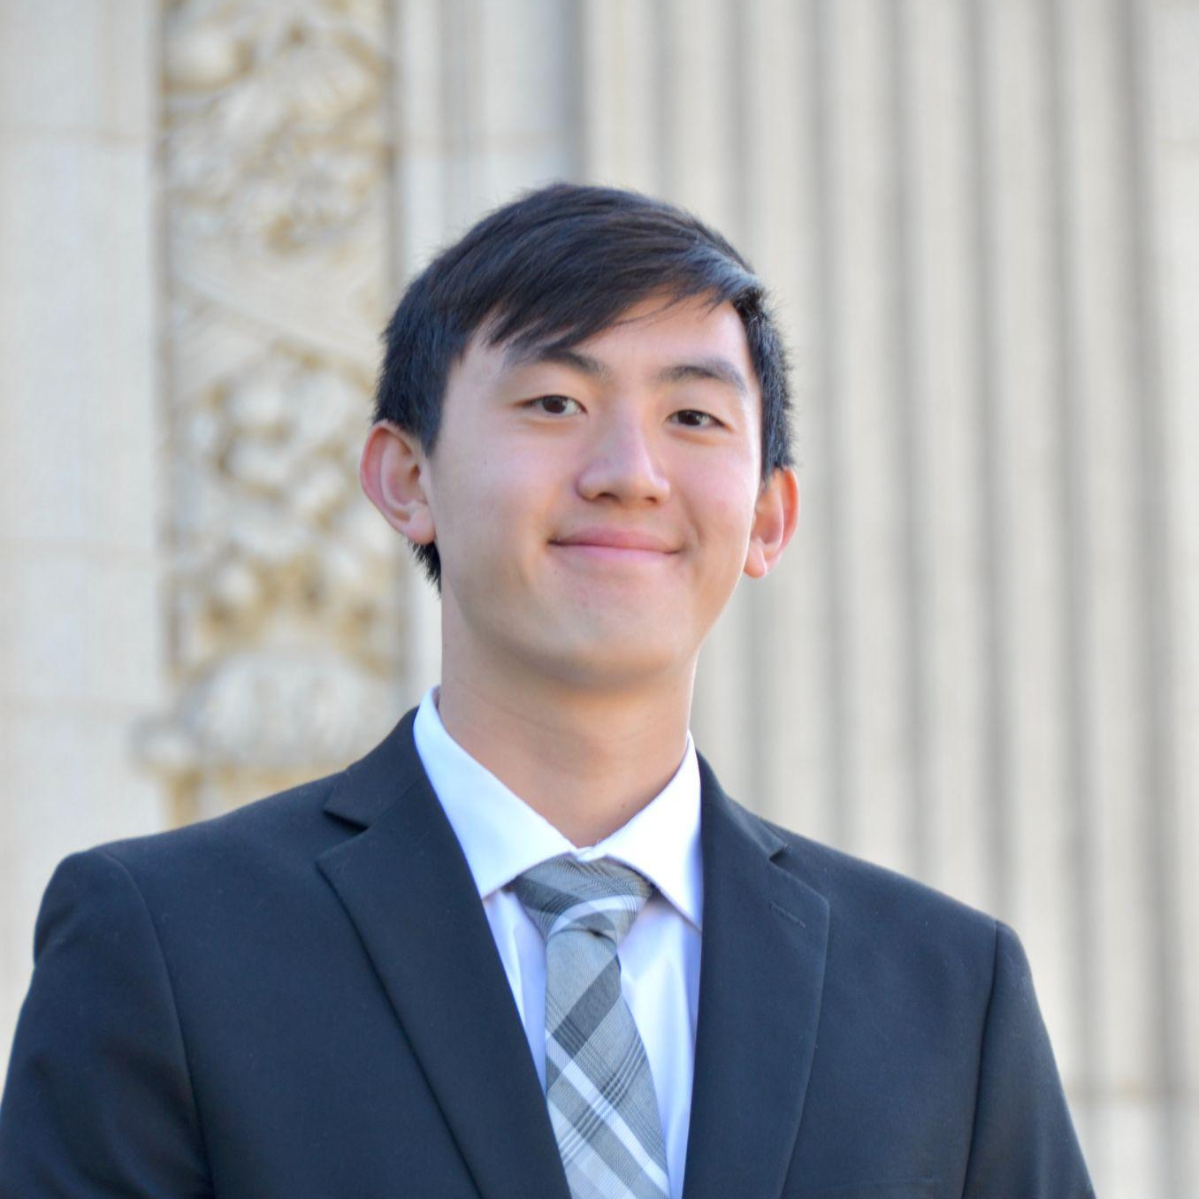
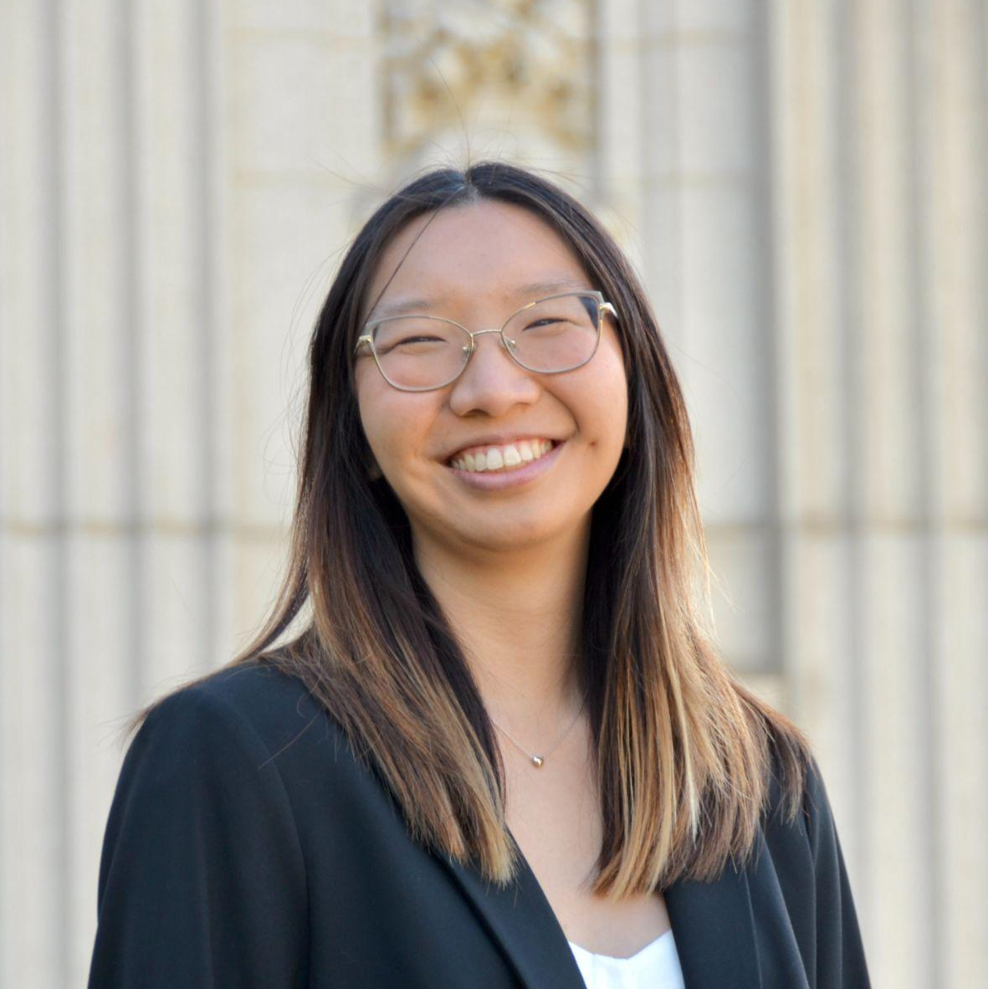

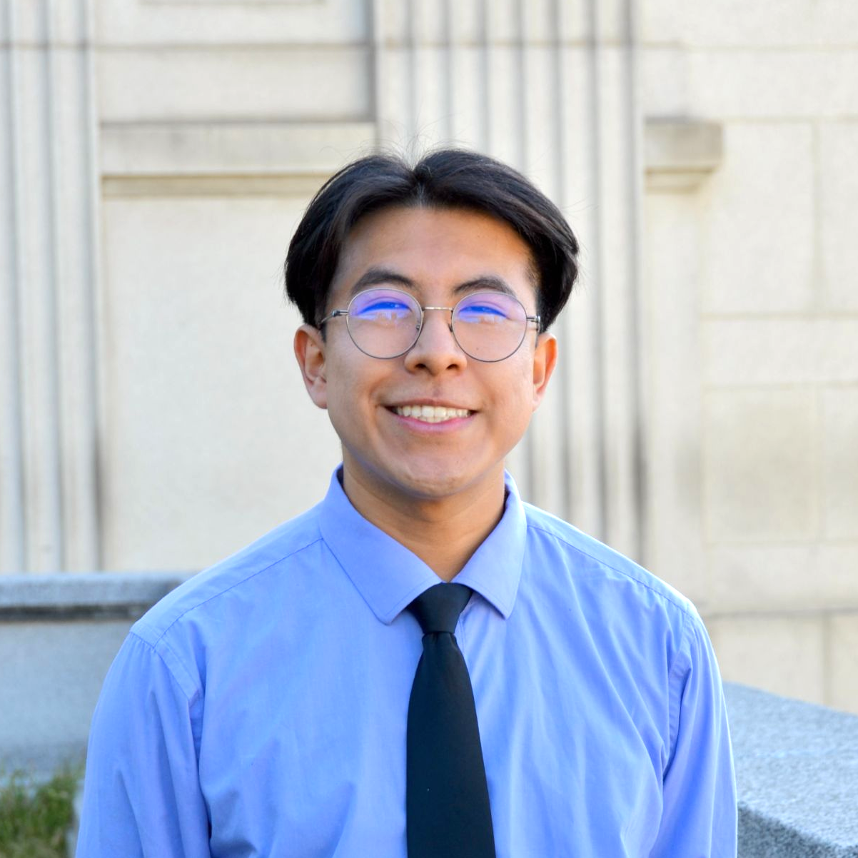
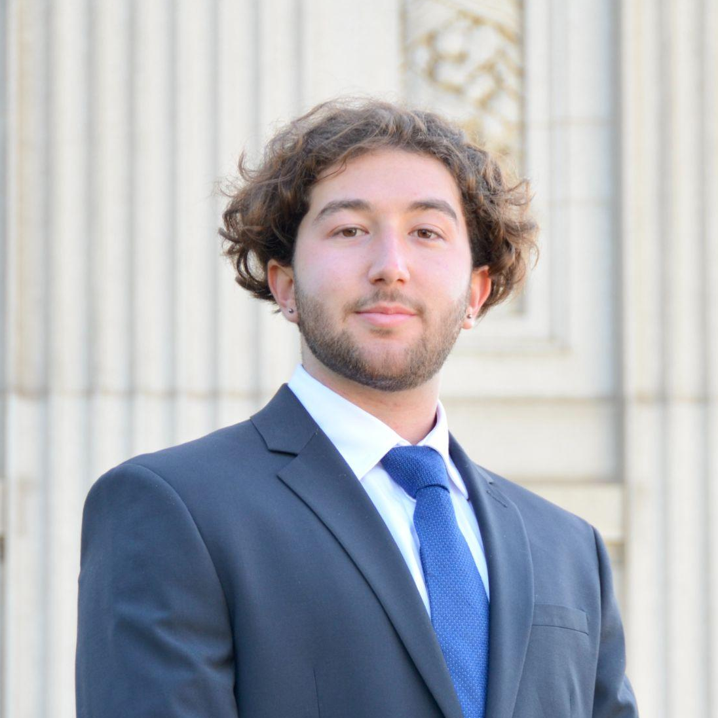
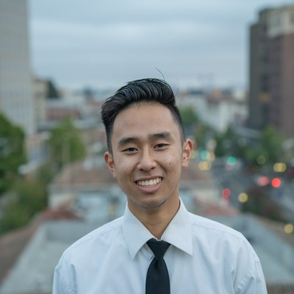
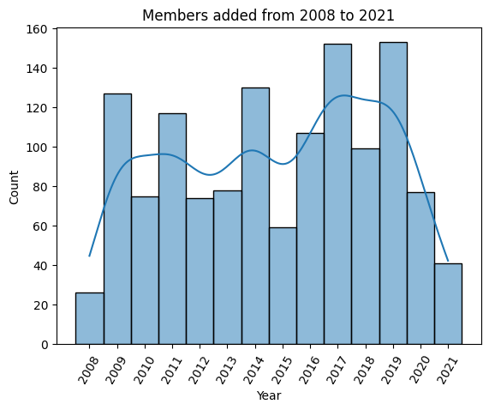
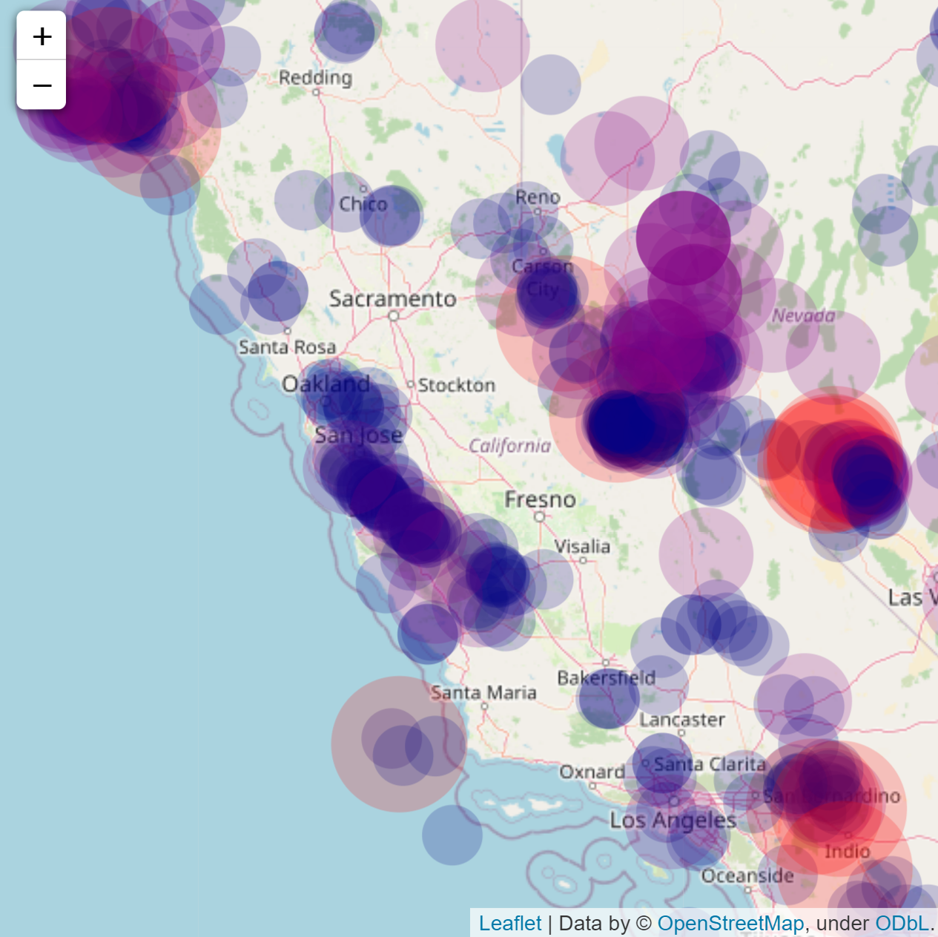
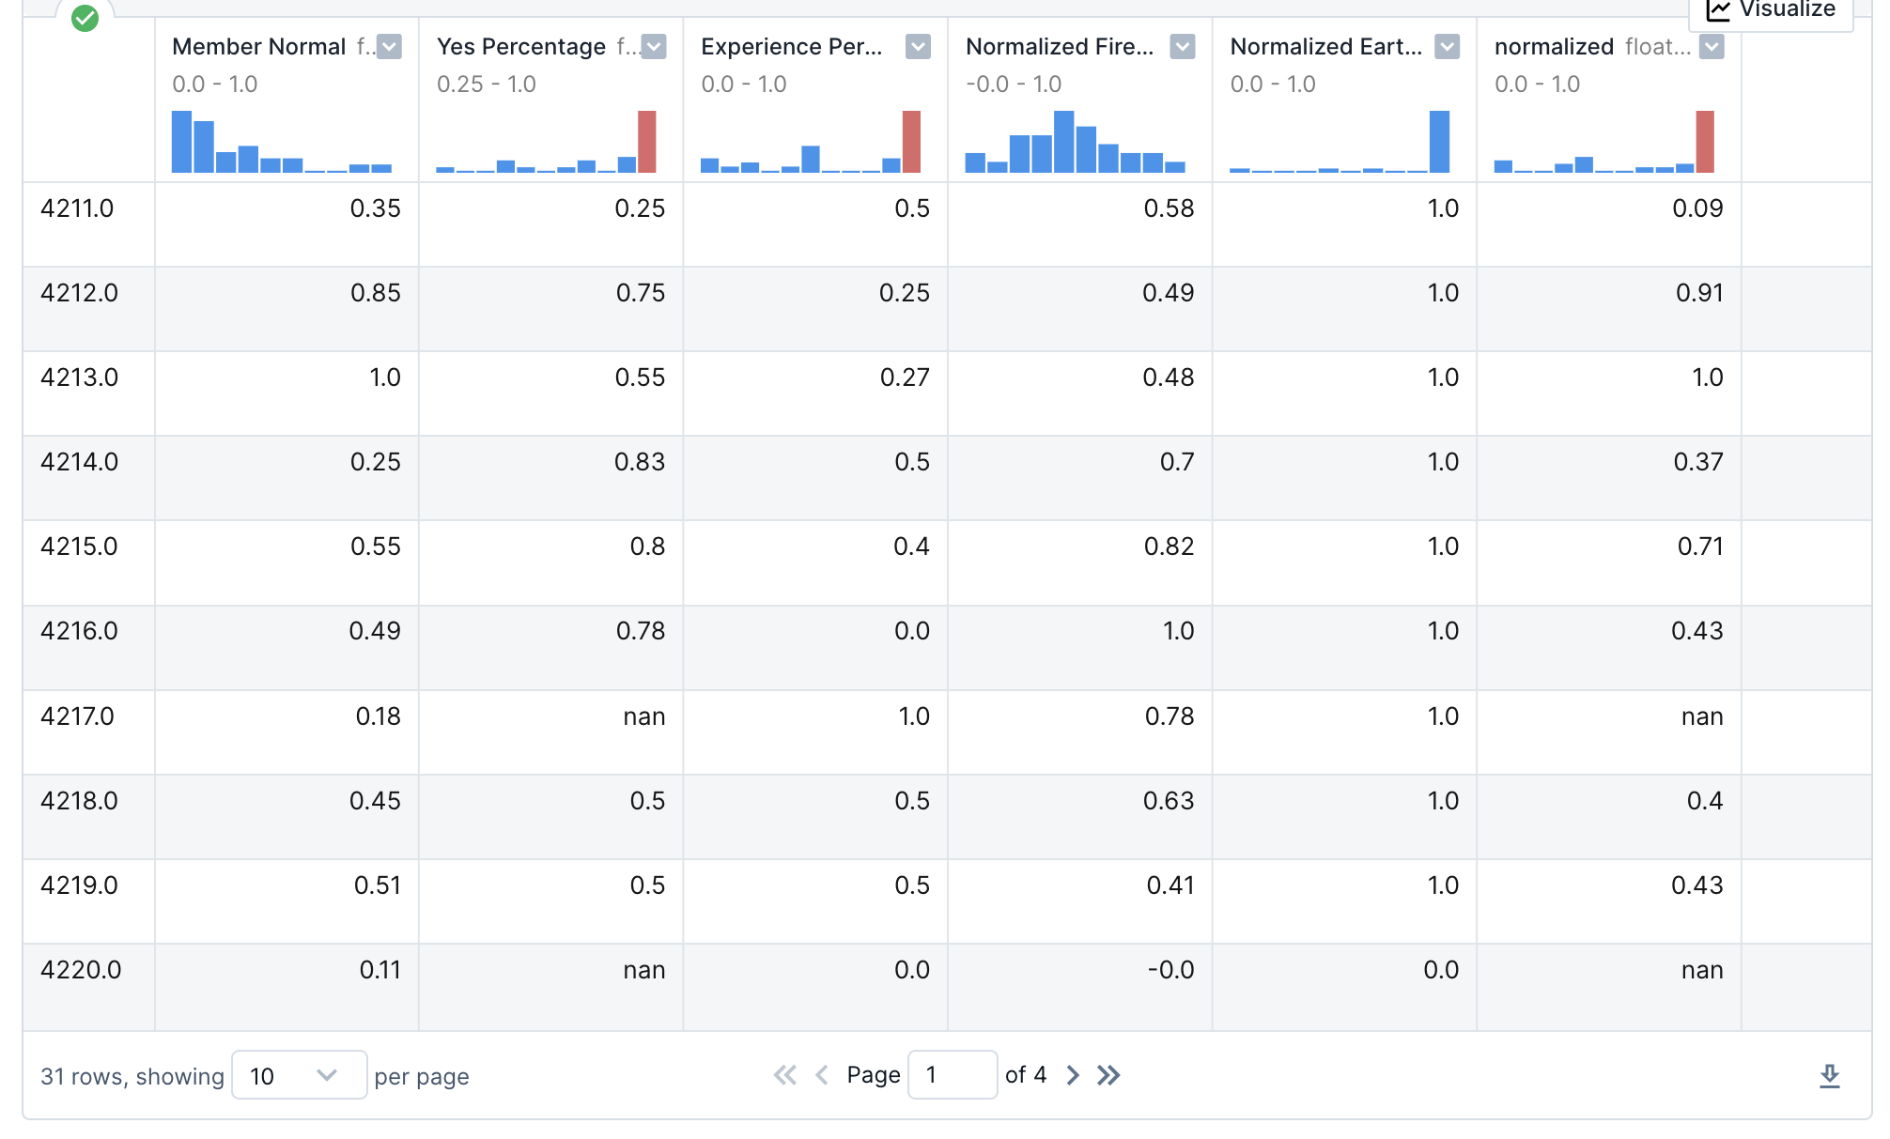
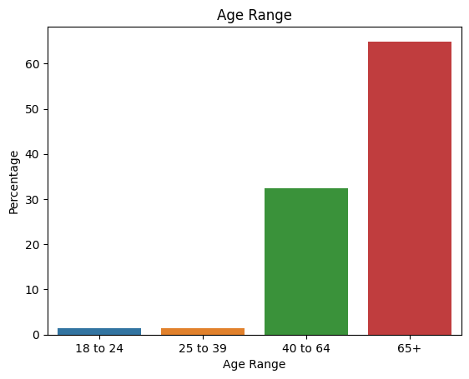
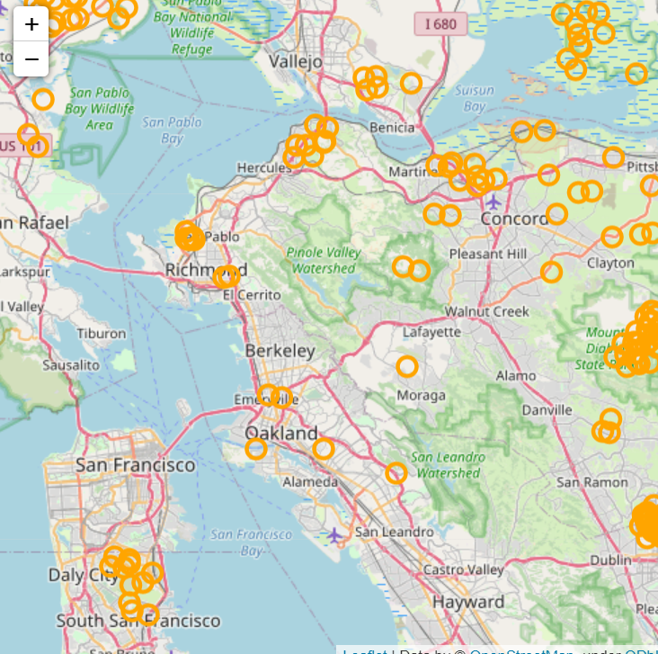
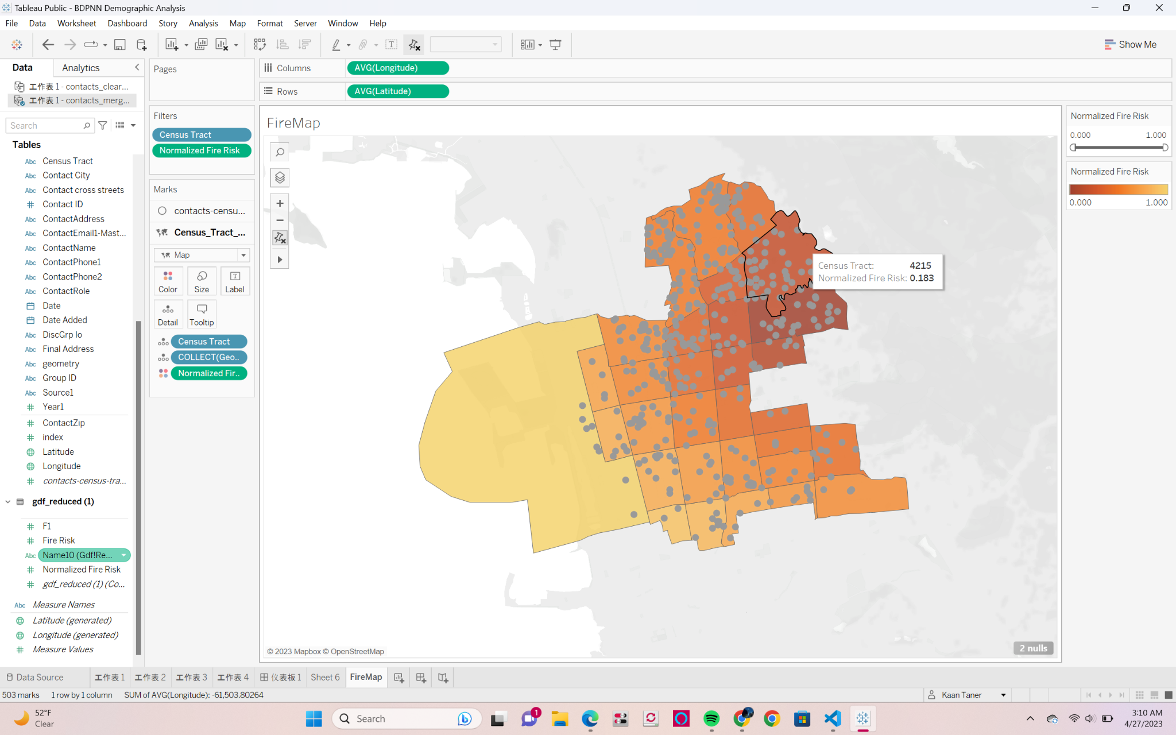
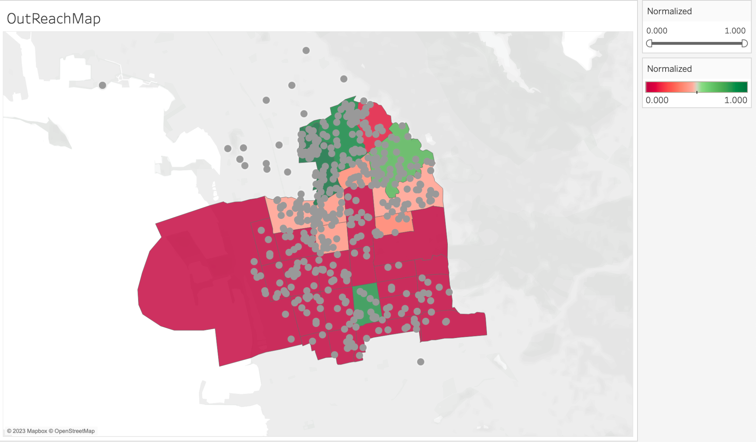
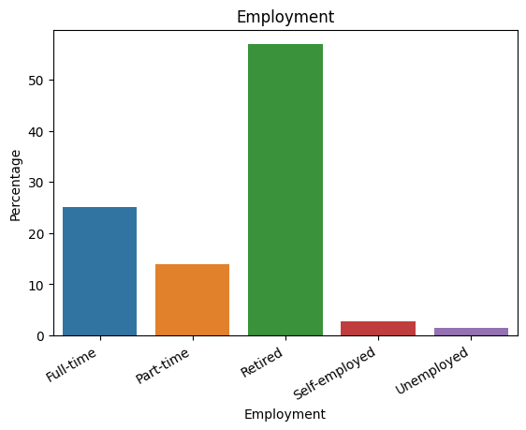
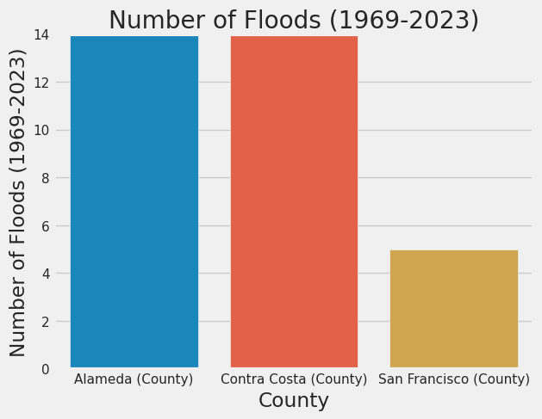
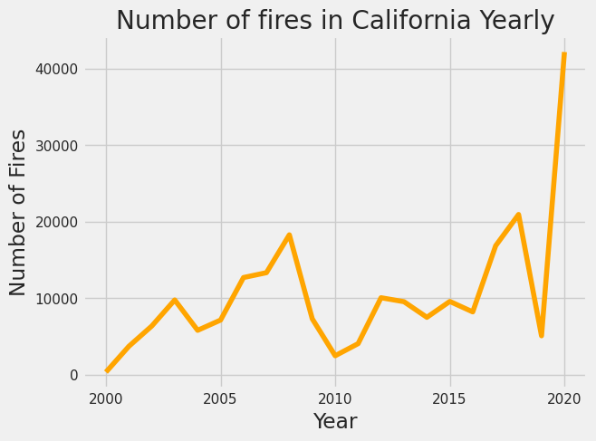
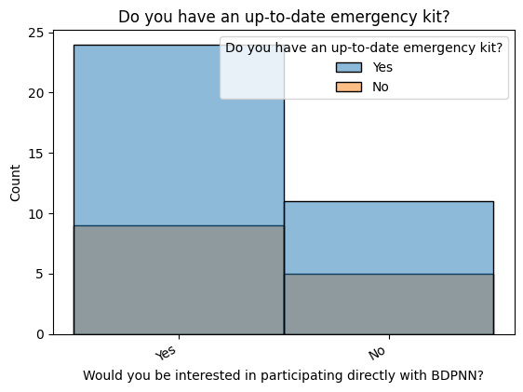

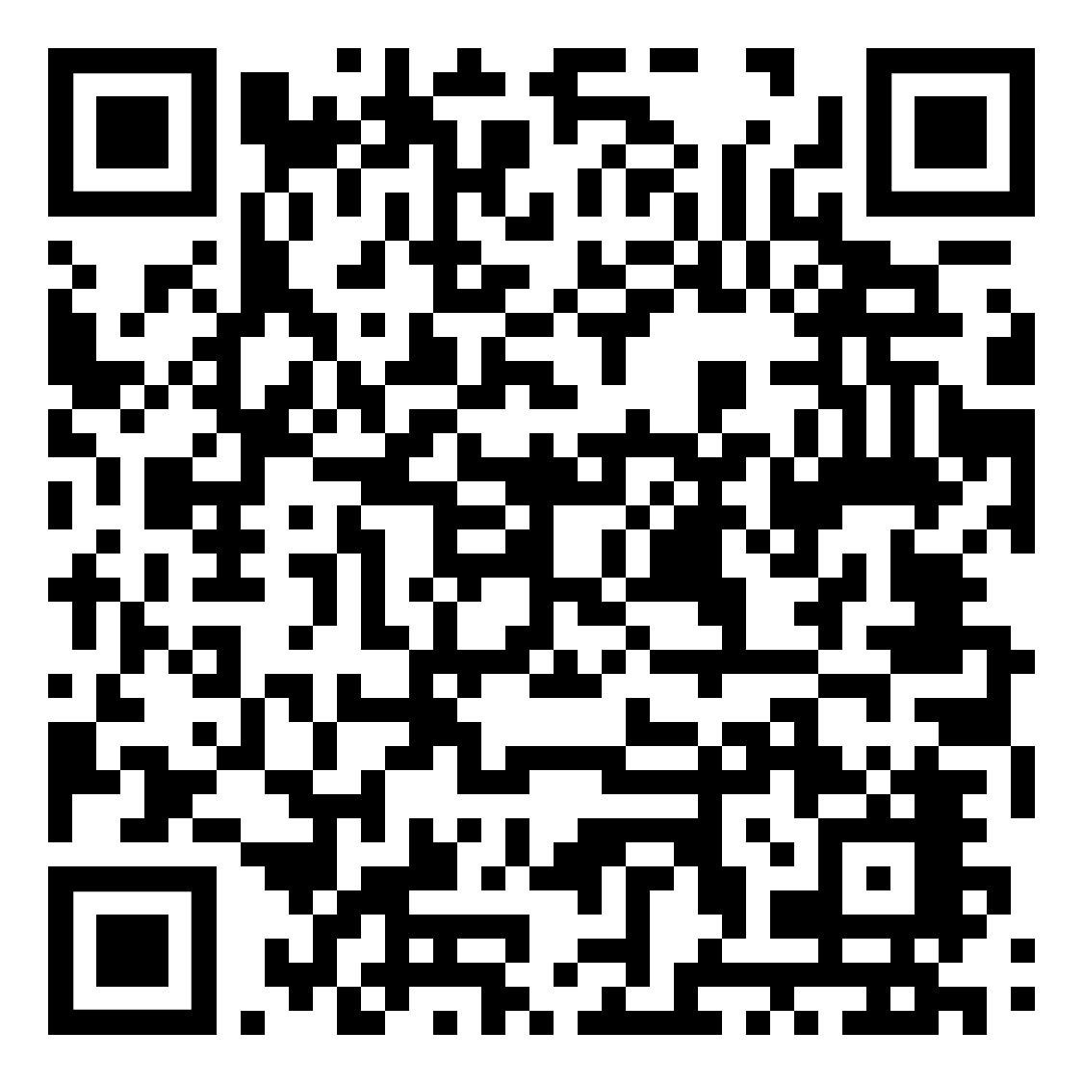
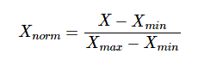

Berkeley Disaster Preparedness Neighborhood Network Member & Disaster Analysis
Manan Bhargava & Riya Singhal (PMs), Susan Yang, Erin Tam, Kaan Taner, Edwin Liu, Victor Cruz Ramos
DataGood at Berkeley
Abstract
Results & Discussion
Client: BDPNN is a volunteer organization that promotes natural disaster preparedness and organizes city-wide response.
Goal: Use BDPNN’s member list datasets and disaster zoning, we strive to provide recommendations to:
1) Identify community outreach locations
2) Categorize, mobilize, and engage existing volunteers
3) Identify disaster zones at higher risk for natural disasters in Berkeley including Earthquakes, Wildfires, and Floods.
Through overlaying member data with zoning data, we categorize members into zones for emergency responses. We also overlay natural disaster data with members to determine regions most at-risk for regions with less community members, organization, or resources; with this analysis, we hope to improve outreach, distribution of emergency kits, and improve emergency preparedness for future disasters.Through utilizing Pandas, Folium, and Tableau for data visualizations, we revamped their database to provide relevant insights.
Member and Demographic Analysis
We did some plotting and analysis on the survey of the BDPNN members and we made the following visualizations:
Disaster Analysis
Using python libraries such as Geopandas, and Folium, and we would later move them to Tableau to better display our findings:
Scoring Areas for Outreach
Using various features such as members’ rate of future participation, having related experience of dealing with disasters, wildfire risks, earthquake risks, etc. The disaster risks are calculated based on various factors. For example, earthquake risk is calculated based on distance from longitude and latitude, Modified Mercalli Intensity, depth, etc.
This is the visualization of members added to BDPNN mail list and io group from 2008 to 2021. We can see that there are several peaks for example in 2009, 2011, 2014, 2017, and 2019 that have relatively high numbers of members added into BDPNN. In 2019, there are 160 new members, which is a great development. Strategies or activities held in that year are a good indicator and referential source for the future development of BDPNN.
This map shows the locations of Impactful Earthquakes (Magnitude 4.5 and above) over the past 90 years. We see that a lot of them are focused around the fault lines. One major fault line goes through San Jose and San Francisco and another through Fremont and to the east of Oakland. The earthquakes in this area are the ones that are most impactful for Berkeley, Albany, and other Bay Area residents.
In the end the safety rate based on each census tract in Berkeley is calculated based on the Heuristic formula. The higher the Heuristic value is, the less risky it is in that specific area.
Most people are in the age range of 65+. This shows that BDPNN has many senior members and has successfully connected with experienced groups in the community. BDPNN can probably consider expanding its membership network to younger members as well, for example the groups of 18-24 and 25-39 to broaden their age scope of membership.
These are the locations of Bay Area fires near Berkeley since 2000. It seems like fires are more common in Richmond and Oakland than in Berkeley. They also occur more consistently in greener areas than in the cities, over and over again in roughly the same spots. This reflects how over time, fires occur in grass fields and forest areas multiple times.
Map Visualization
Using Tableau, we mapped where each of the members lives in Berkeley and overlaid a map of Berkeley divided into census tract groups. Below is the visualization of Fire Risk at Berkeley. Places like 4215 Census Tract (Northeast Berkeley) have higher risks of fire disaster.
Methodology
1
Data Collection
BDPNN provided demographic and mentorship data. Since BDPNN’s founding in 2009, the organization has developed and maintained a database of information containing:
- A list of member contact information
- Berkeley neighborhood block groups
- I/O mailing lists
- Record of workshops held
California natural disaster data was sourced from various online resources.
- Flooding/Wildfire datasets were sourced from Kaggle.
- Earthquake datasets were sourced from the US Geological Survey
About 50% of the members are retired, making it the largest group within the this demographic. Furthermore, full-time employment is the second-majority within the group. This in turn also makes sense since the age demographic is 65+, and it would make sense most of those members would be retired.
2
Exploratory Data Analysis
Data visualizations were made in DeepNote notebooks using Python libraries and Tableau to identify patterns/abnormalities. Tools Used: DeepNote, Python, Pandas, Numpy, Matplotlib, Seaborn, Geopy, Geopandas, Folium, Tensorflow, Tableau
Fire Risk Map
Outreach Recommendation Map
3
Data Cleaning & Processing
The data was loaded into shared notebooks to fix or remove incorrect, corrupted, improperly formatted, duplicate, or incomplete data within the dataset.
Tools Used: DeepNote, Python, Pandas
Conclusion
Around ⅔ of BDPNN members will be interested in participating directly with BDPNN in the future and most of them have an up-to-date emergency kit, which is good to help improve the preparedness of disasters. However, people with no up-to-date emergency kit are more reluctant to continue participating compared with those who have. It is recommended that BDPNN can provide members with emergency kits or hold workshops to help members prepare.
In conclusion, when we observed the demographics of BDPNN members, and reached a number of crucial observations. Firstly, we observed that the majority of the members were largely in the 65+ age category. Furthemore, we noticed that the largest proportion of the members were retired followed by full-time working adults. Based on our statistical analysis, we recommend that BDPNN focus their outreach efforts on census tract groups 4211, 4236, 4222, 4225, 4214, 4223, 4218, 4219, 4235, and 4216 since those areas have been identified as requiring the most attention due to their risk for natural disasters and willingness of experienced members to volunteer.
4
Heuristic Building
Here we chose 5 features as the input of our formula, and each of them have been normalized using below formula.
These visualizations display fires and floods within California giving us more insight as to how often disasters can be expected.
Scan the QR Code!
View our interactive data visualization here!
Acknowledgements
We’d like to thank the Berkeley Disaster Preparedness Neighborhood Network and board members, City of Berkeley, ArcGis, DataGood, SAAS, Kaggle, and the United States Geographical Survey for the data collection, analysis, and visualization process.

